Slide 1

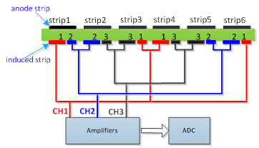

Mini Oral
An Extensible Induced Position Encoding Readout
Method for Micro-pattern Gas Detectors
Chanel:comparsion | Strip:position
CH1>CH2 CH2>CH3 CH3>CH1 CH1>CH3 CH3>CH2 CH2>CH1 | Strip 1 Strip 2 Strip 3 Strip 4 Strip 5 Strip 6
Fig. 1. Induced position encoding readout schematic
Table. 1. Decoding table of 3 readout channels
Row | Encoding list
1 | 12 | 21
2 | 13 | 32 | 23 | 31
3 | 14 | 42 | 24 | 43 | 34 | 41
k-1 | 1k | k2 | 2k | k3 | 3k | k4 | … | k(k-1) | (k-1)k | k1
$${（xy）}_{i}=\left\{ \begin{aligned} n,k R=1 \\ \left(k,\frac{R}{2}+k \right) i=even number \\ \left(\frac{R−1}{2}+k,k\right) i=odd number \end{aligned}\right.$$
$$i_{(x,y)} =\left\{ \begin{aligned}\left(y−1\right)\left(2n−y\right)+1 encoding：ny \\ \left(y−1\right)\left(2n−y\right)+2\left(x−y\right)+1 encoding: xy \left(x>y \right) \\ \left(x−1\right)\left(2n−x\right)+2\left(y−x\right) ending：xy \left( x<y \right) \\ \end{aligned}\right.$$
Table. 2. The encoding list of n readout channels
Decoding formula
Siyuan Ma

Slide 2
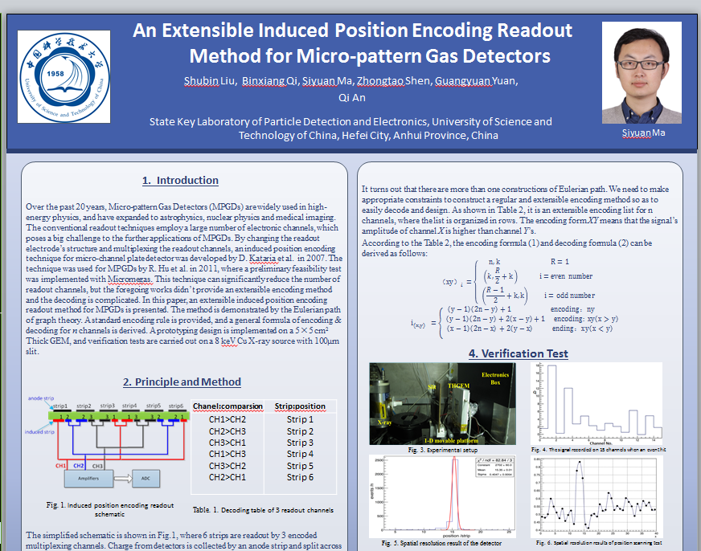
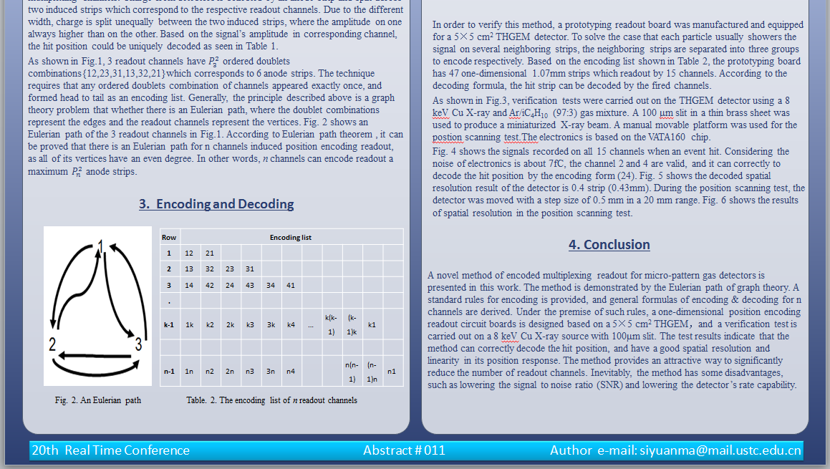
Mini Oral
Poster
Introduction
Encoding & Decoding
Experimental and results
Method
Siyuan Ma

